Slide 1
Stat 495R – Presenting Data
Week 1
Jeff Parker
Sept 2, 2020

Slide 2
Agenda
Introductions and Review Syllabus
Data viz’ of the week
Different modes of data presentation
Understanding context
Elements of PPT templates
Showcase of PPT templates
How to make a PPT template

Slide 3
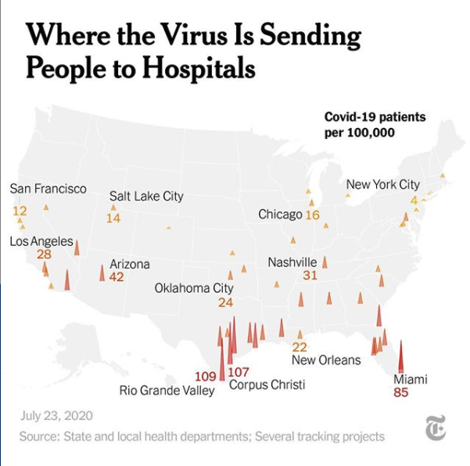
Data Viz #1
Notes:
What type of graph is this?
Bar with a geographical element
What is the story?
Virus is more severe in the south
What are the dimensions used to convey the story?
Color, bar height, geography
What are the elements?
Title – Is this is a question?
Source, date, logo
Explanation
Data labels

Slide 4
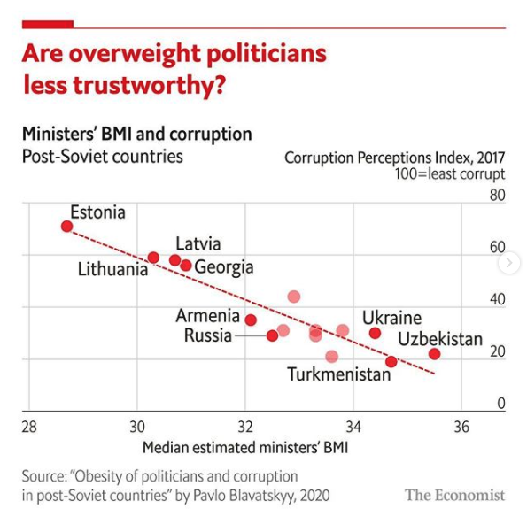
Data Viz #2
Notes:
Scatter plot
What is the answer to the question?
Yes – they are untrustworthy
How could this be improved?
Why is the corruption index reversed?
What elements are similar between the this and #1?
Not every point is labeled, some are transparent,
Same title, takeaway statement, explanation, source, logo
What is the math technique used here?

Slide 5
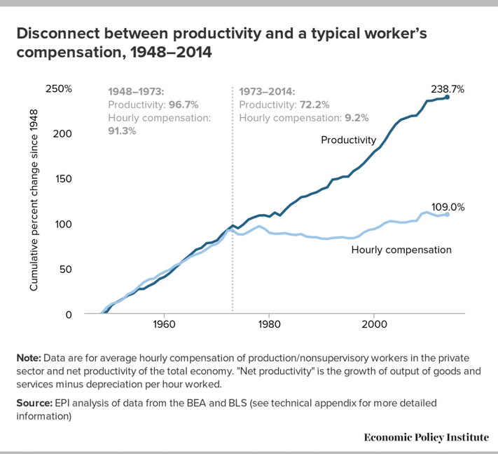
Data Viz #3
Notes:
Line chart
What is the story?
What should be done policy-wise?

Slide 6
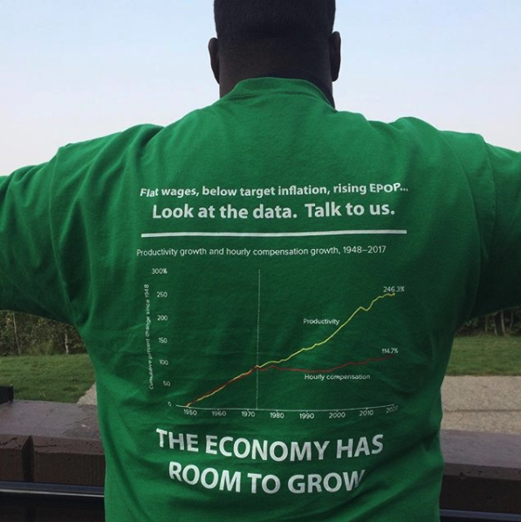

Slide 7
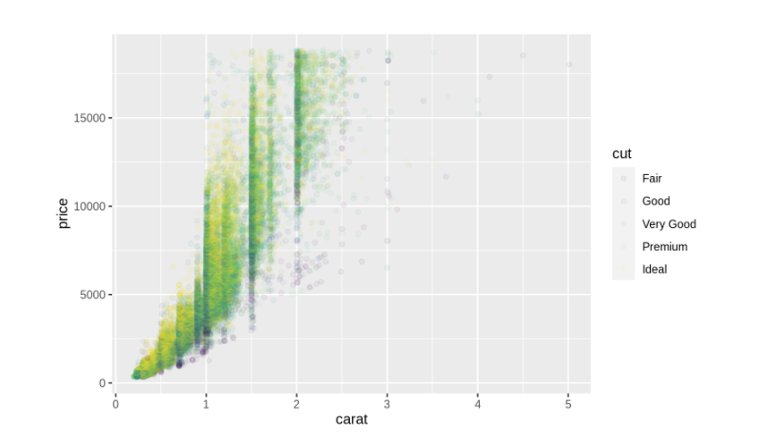
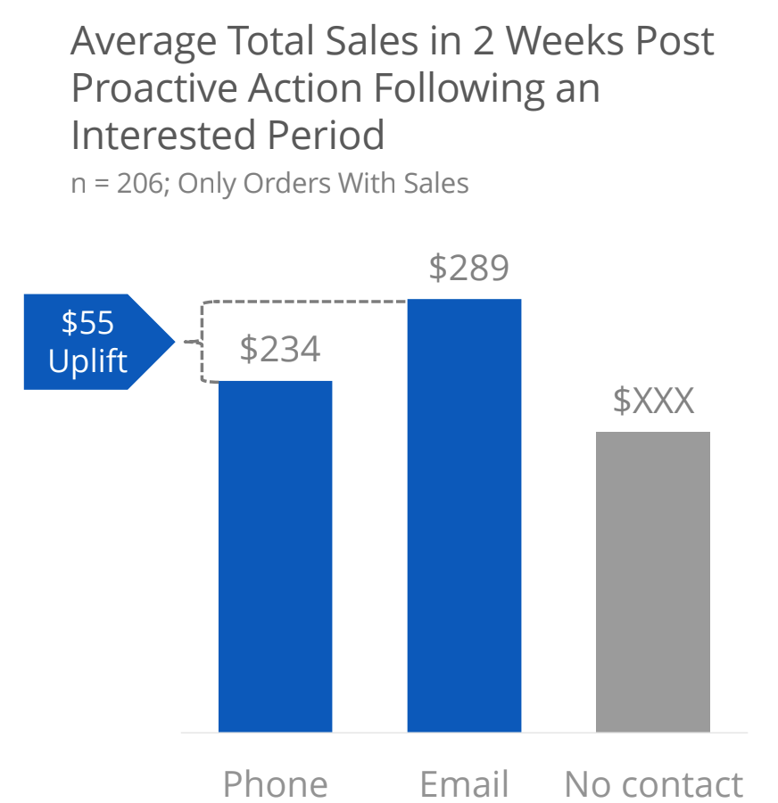
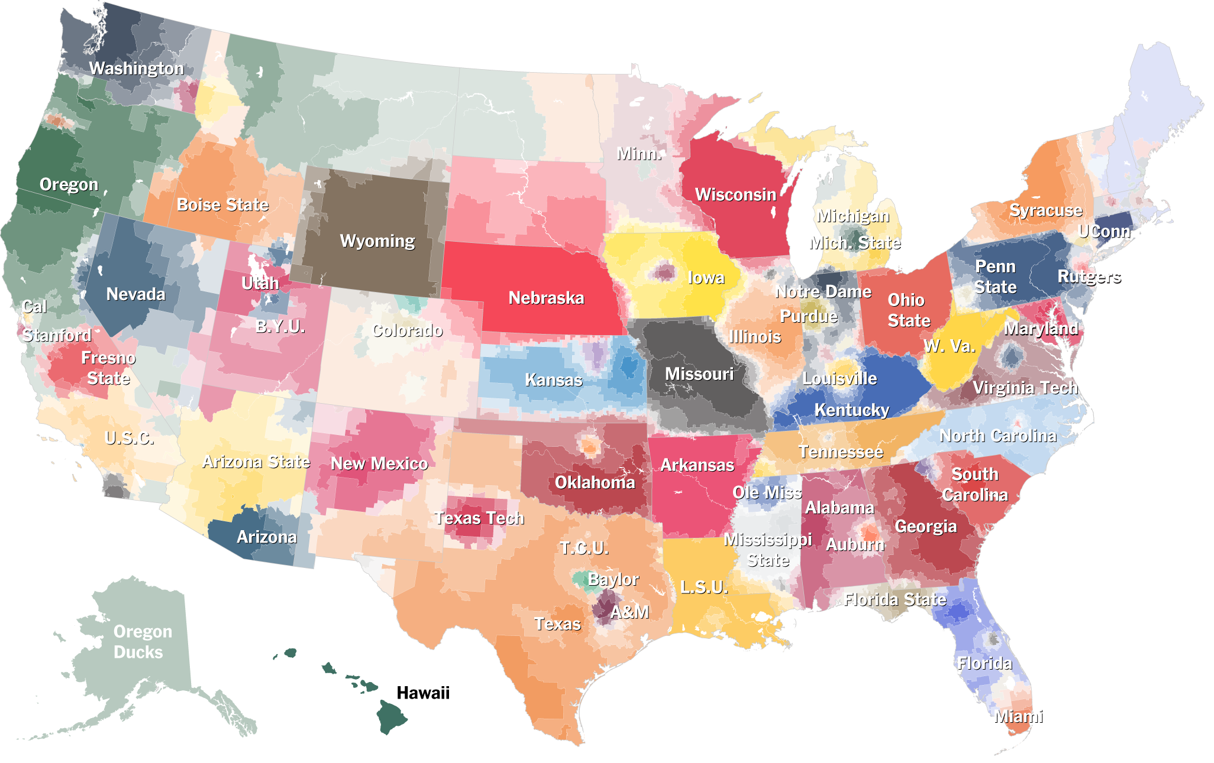

Applications of Presenting Data
Analysis and Exploration
Information Graphic and Presentations
Entertainment
Art

Slide 8
What You Will Learn – through repetition
Principals
Gestalt
Structured Analytical Thinking
Telling a Story with Data
Convincing Communication
Marks and Channels
Visual Perception
Forms
Bars, Dots, Pie, Lines
Waterfall, Marimekko, Heatmaps, Harvey Balls, Radar, Matrix
Chords, Sankey, Maps, Network, Sunburst, Trees, Steam
Tools
R
ggplot
RShiny
Rmarkdown
Blogdown
Officer
Plotly
Much more
PowerPoint
Tableau
Python
Notes:
Pot Analogy

Slide 9
Why Presenting Data is Important
“Skilled in Microsoft Office? So is everyone else!”
In school, we learn to put words into stories and separately we learn math – but we never learn how to put numbers into stories
You may do a ton of excellent work, but people only see your presentation!
Notes:
Anyone can use technology to make graphs now – but few people are natural at it and many terrible graphs are created.
Can be the difference between success and failure

Slide 10
“Always Be Closing”
ABC
Notes:
A visualization has a purpose. That purpose is to convince someone of something.
Communicating
Convincing
Presenting takes some salesmanship
How does the class feel when asked to “show data”

Slide 11
“Facts are Friendly. Facts are the bricks with which you will lay a path to your solution and build pillars to support it. Don’t fear the facts.”

Slide 12
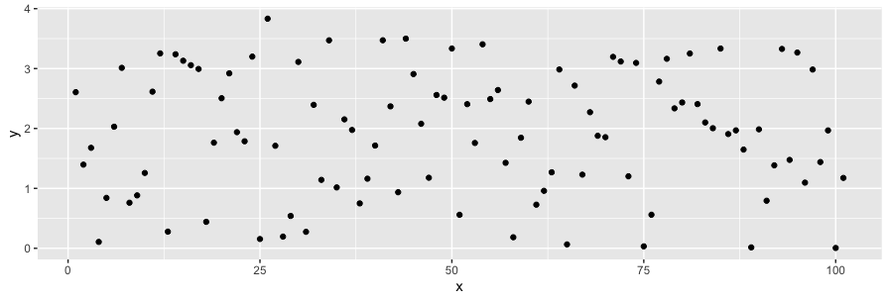
Visualizations Improve and Augment Cognition
1.96919714 1.44837468 1.28526034 1.52241275 0.60742931 0.07751094 1.65598157 1.36578263 0.01366646 2.60198512 1.12462263 2.30993818 2.16758954 1.82384609 1.21270992 1.01734025 1.29327708 3.35235444 2.98989387 1.57200266 0.43511862 1.49675821 0.65324330 2.61658523 3.29216131 3.83243500 2.99342128 3.19529555 0.42277107 0.95141138 0.13731128 1.66125822 0.27336900 2.11430184 1.72989187 2.10090171 3.37774170 1.49454212 1.85480490 1.90432889 1.90252130 2.93795408 3.18833318 2.25660977 2.92954907 2.76308081 2.77506778 1.62413999 1.78804352 1.72663007 2.82184130 0.90681637 1.18965107 0.45530713 0.95718503 0.38355708 1.66165591 2.26545455 1.90061222 0.95347495 3.47214744 0.95345099 1.93877735 2.64275123 0.03735214 3.28656989 1.18531530 0.72788864 2.30269887 3.15414669 1.41613997 3.14091564 2.79224672 1.26697921 2.00005215 3.15366003 3.49872568 3.23832825 3.02824194 1.55988420 0.41562039 0.74125650 3.10384220 3.12612068 2.59103603 0.71539273 1.76341760 2.15933272 1.91690727 1.43069326 2.31733994 0.97117468 3.23812448 1.88908563 0.31009348 0.89555400 3.00989663 3.16323551 2.48981795 2.92570681 0.27581877
Notes:
Humans are hard-wired for visual communications
The visualization part is the richest, most responsive, highest bandwidth part of our brain

Slide 13
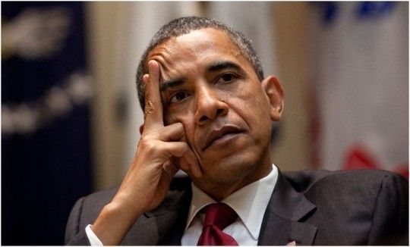
Cognitive Load
Notes:
Reduce cognitive load
Sell the story
Assume audience has limited resources

Slide 14




Modes of Delivery
Slides
Decks, Presentations, PowerPoints
Great for speaking engagements, but should be short and punchy – not speaking bullets or detailed analysis
Documents
Blogs, Notebooks, Papers
Great for detailing work steps or analysis process so should clear and appropriately detailed – no skipped steps, but concise as possible
Slide-uments
A slide deck, but it must be self-explanatory
What consultants (internal and external) should provide – punchy, clear storytelling with all relevant details
Dashboards
RShiny, Tableau, Excel
An interactive analysis tool, sometimes with a point
Notes:
We are going to cover all of these modes in class
Slides today, because it’s important to get this one right first, but it’s not as exciting

Slide 15

Who is your Audience?
Adjust your tone
3 to 5 minutes per slide
Printed presentations for notes
Practice presenting
Notes:
See Paula’s training on this
Who is your audience, who are you, what is the mechanism

Slide 16
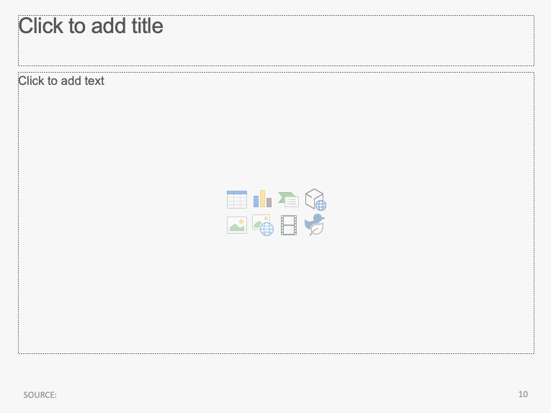
Elements of a PowerPoint
Title Placeholder
Content Placeholder
Footer
Page Number

Slide 17
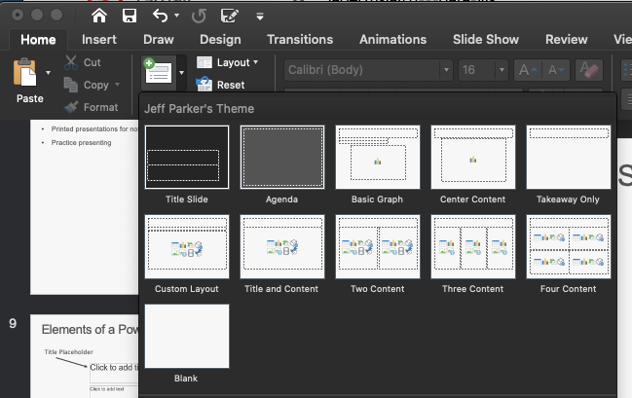
Slide Options
Notes:
Copy and pasting slides cause weird issues,
Better to copy-and-paste content.

Slide 18
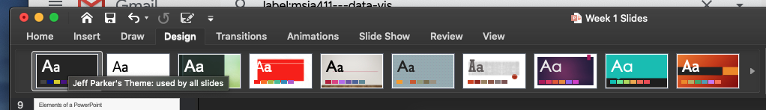
PowerPoint Themes
Notes:
Never touch these theme’s

Slide 19
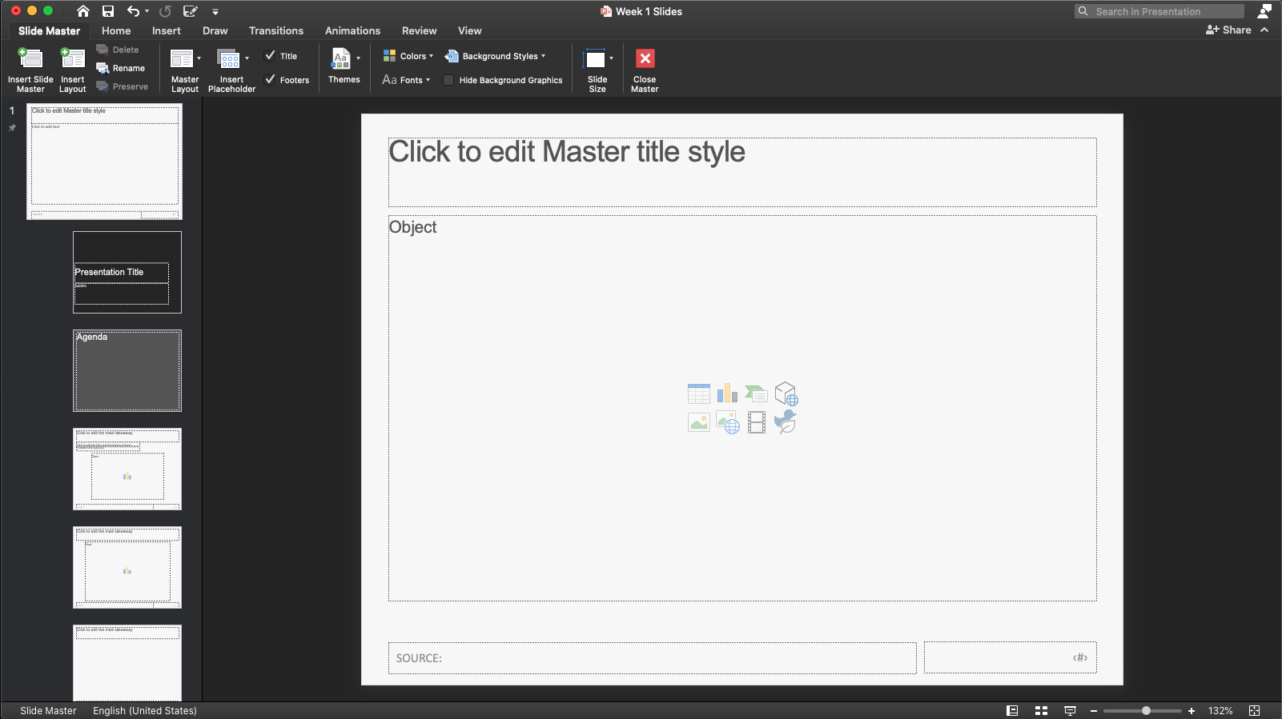
Slide Master
Rename your master
Add layouts, rename your layouts
Notes:
There can be more than one slide master – this is how slide formatting get’s messed up

Slide 20
Slide Layouts
Font color and family applies to all slides unless changed at the individual layout
Changed to color to white
Notes:
Also consider the dimensions. Good for printing or good for presenting?

Slide 21
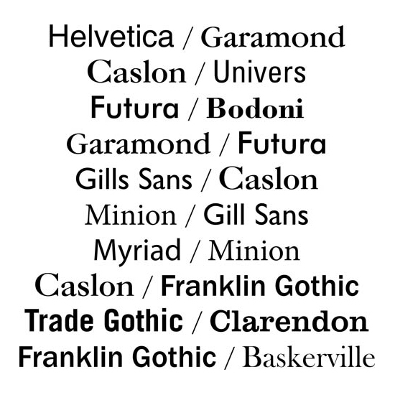
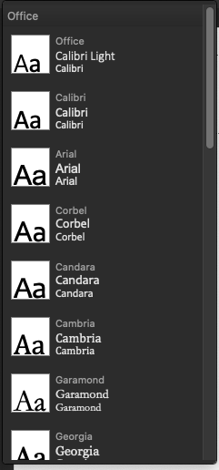
Font Pairs

Slide 22

Deco-style Fonts

Slide 23
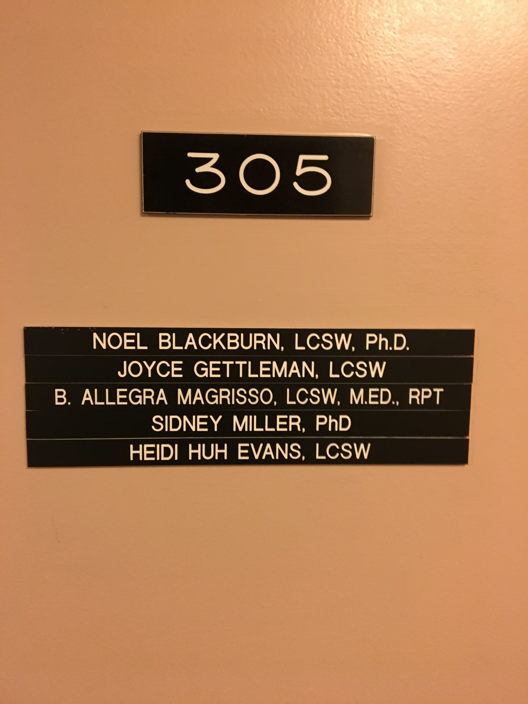
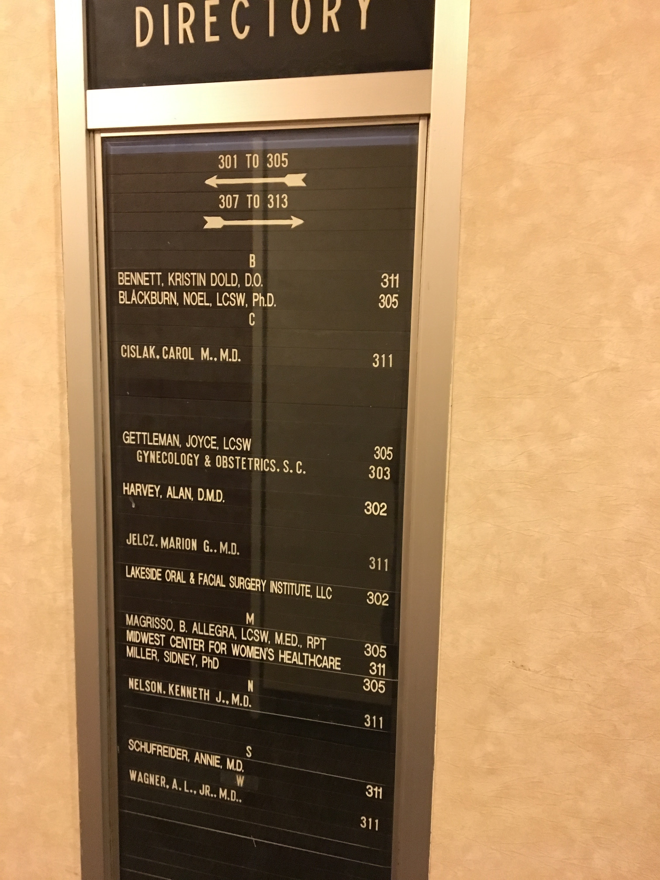
Deco-style Fonts

Slide 24
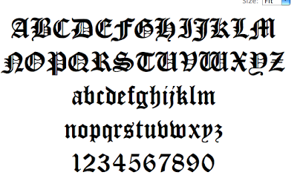
Font’s convey meaning and tone
Notes:
Black letter? Nazi, Old English, or Death Metal

Slide 25
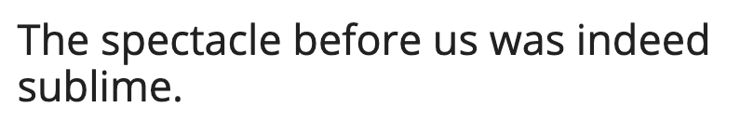
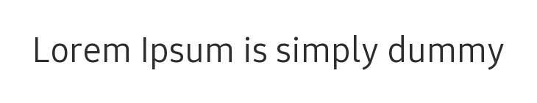

Corporate Fonts
Notes:
Guess the company

Slide 26

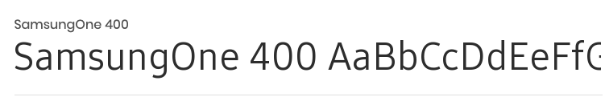

Corporate Fonts
Notes:
Cor

Slide 27
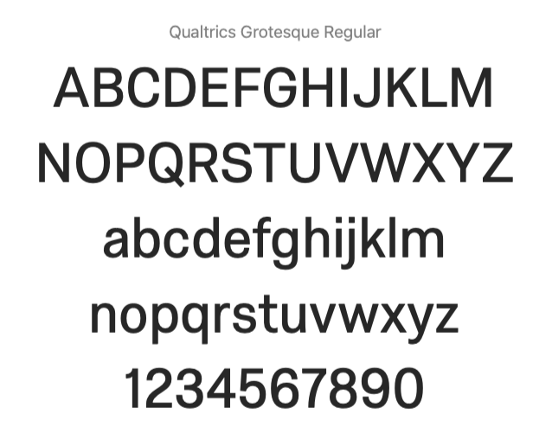
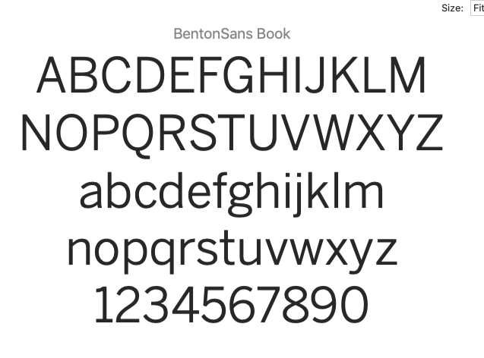
Qualtrics Fonts

Slide 28
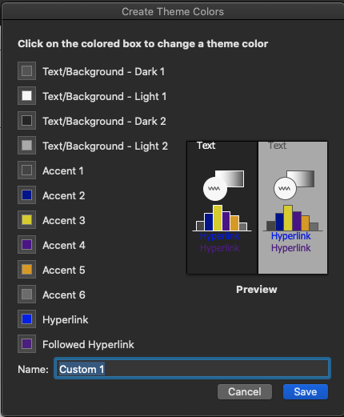
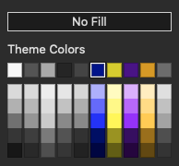
PowerPoint Colors
The default color
SAVE YOUR COLORS

Slide 29
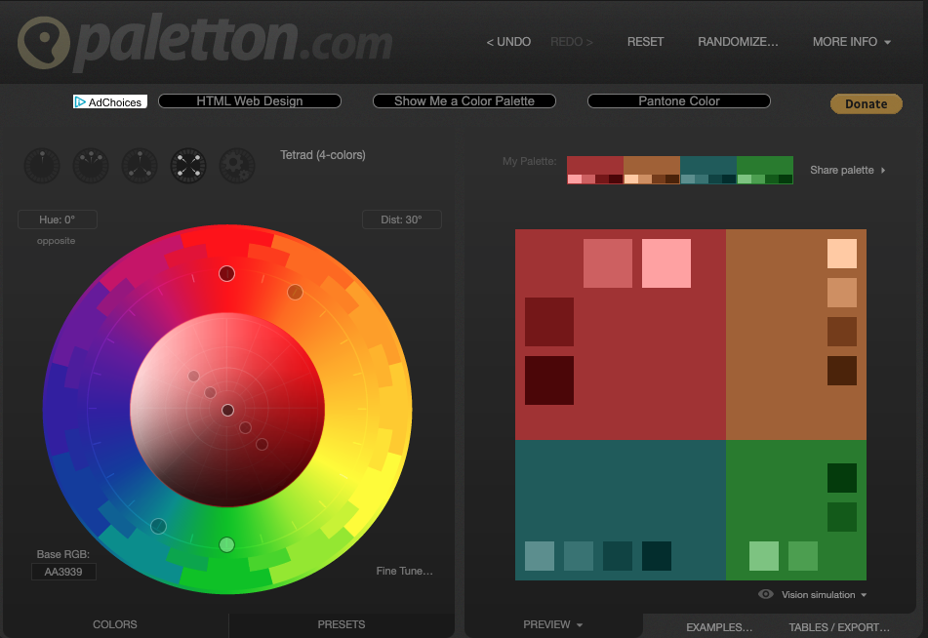
Color Palettes

Slide 30
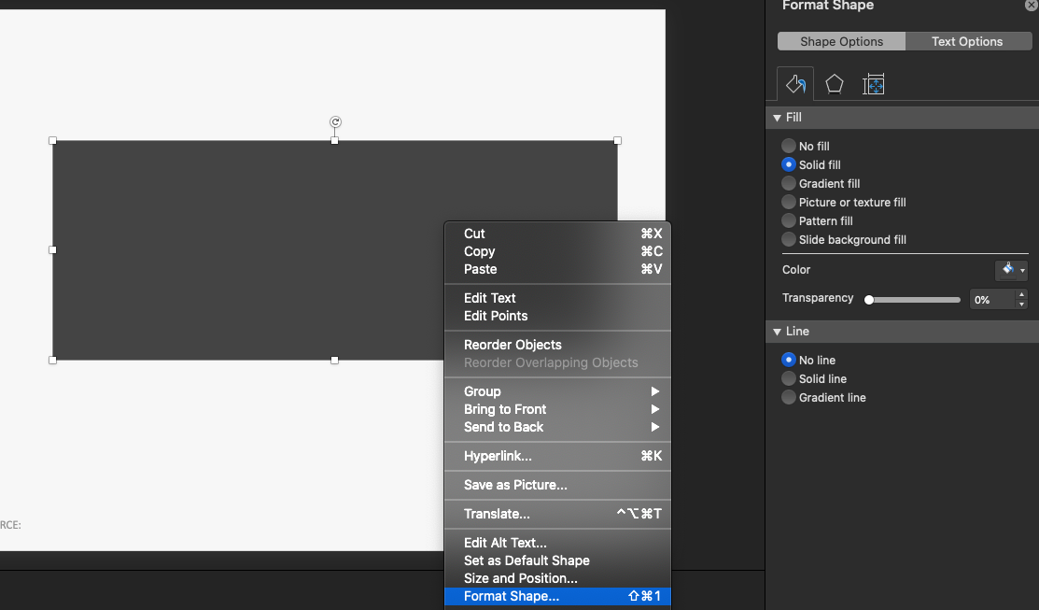
Shape Format
2. Format fill, line, transparency and text options
1. Right click, “Format Shape”
3. Right click again, ”Set as Default Shape”

Slide 31
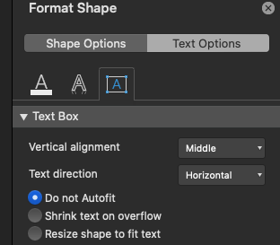
Do not Autofit
Resize shape to fit text
Shrink text on overflow
Notes:
Be mindful of text alignment, text position, margins, and

Slide 32
Chart Templates
Notes:
Default chart

Slide 33
Chart Templates
Notes:
These should appear… but they don’t work

Slide 34
Considerations When Making a PowerPoint Theme and Slide Master
Everything is editable… but it’s Microsoft
Don’t use animations or effects
Don’t use 3D, pattern fills, reflections or glows
Flat themes print and present best
Hotkeys:
Laser Pointer: option + left click
White and Black Screen: shift + W or shift + B
Launch presentation: command + return

Slide 35






Choose a Company

Slide 36






































Slide 37
Week 1 Assignment
Create your own PowerPoint template (can also be Google Slides or Keynote)
Access the Slide Master
Choose a good font pair, font size and color on the master slide
Choose master elements you wish to include (title, content, page number, footer, date)
Rename your slide master
Create 4 to 10 slide layouts – name each one
Choose a color scheme
Set your default shape
Email me your template by EOD Moday

